Slide 1
PSYC10009: Abnormal Behaviour
Dr David Turk

Slide 2
Lecture 12: Abnormal Psychology
Reading:
Kalat, Chapter 15
Available on Blackboard eReserve

Slide 3
Mental illness results from biological predispositions and a person’s experiences.
So need to understand both to treat mental illness.
Diagnostic and Statistical Manual (DSM IV) lists many different disorders.
We will focus on:
Mood Disorders (Depression and Bipolar Disorder)
Schizophrenia

Slide 4
Mood Disorders
Major Depressive Disorder
Many people claim to feel “depressed” when they are sad of fed up with a particular situation. However, major depression is more intense and prolonged than these feelings.
DSM IV criteria for Major Depression: Feel sad and helpless every day for weeks at a time. Feel suicidal, have sleep problems, feel worthless, have low energy, problems with concentration, can’t imagine being happy again.
Absence of happiness more reliable symptom than increase in sadness (Peters et al., 2003).
Depressed patients react normally to sad or distressing images but rarely smiled at comical ones (Rottenberg et al., 2002).
Show a decreased response to happy facial expressions (Monk et al., 2008).
Notes:
Note DSM 5 has some changes in all these mood and schizophrenia disorders.

Slide 5
Mood Disorders
Major Depressive Disorder
5% of American adults have clinically significant depression per annum and 10% experience this at some point in their lives (Narrow et al., 2002).
One-year prevalence varies from less than 5% for Chinese-Canadians to more than 15% in India (Murali, 2001; Tiwari & Wang,2006). Genetics or Environment?
(But standards for diagnosis vary from country to country also).
Childhood depression rates are equal for boys and girls until age 14 when depression more prevalent in female population (Twenge & Nolen-Hoeksema, 2002).

Slide 6
Mood Disorders
Major Depressive Disorder
It is more common to have episodes of depression separated by periods of normal mood (Klein, 2010) than to have long-term episodes.
The initial episode tends to be longer and many patients can identify a stressful event that triggered the onset. For later episodes of depression patients are less able to identify a specific trigger (Post, 1992).
The brain learns how to be depressed and gets better at this over time (Monroe & Harkness, 2005).
The more often you experience an episode the easier it is to have another one (Post & Silberstein, 1994).

Slide 7
Mood Disorders
Major Depressive Disorder
Genetics:
Studies with twins and adopted children suggest moderate degree of heritability for depression (Shih et al., 2004).
But
No one gene shows a strong link to depression (Camp et al., 2005).
Genetic link may be masked by different onset types.
Early Onset (Before Age 30)
Late Onset (Particularly post 45 years of age)

Slide 8
Mood Disorders
Major Depressive Disorder
Genetics:
Early Onset
High probability (40-50%) of other relatives with depression (Bierut et al., 1999).
But also high probability of relatives with: anxiety disorders, attention-deficit disorder, obsessive-compulsive disorder, bulimia, migraine headaches, alcohol or drug abuse and irritable bowel syndrome (Fu et al., 2002).
.

Slide 9
Mood Disorders
Major Depressive Disorder
Genetics:
Late Onset
High probability of relatives with circulatory problems (Kendler et al., 2009).
Need to distinguish between onset times when searching for a genetic link to depression.
Perhaps the effect of a gene varies with the environment?

Slide 10
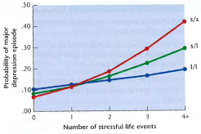
Mood Disorders
Major Depressive Disorder
Genetics & Environment
Serotonin Uptake Transporter Gene comes in both short and long forms. Researchers asked 847 young adults about the number of stressful events (e.g., divorce, redundancy, financial problems) over a 5-year period (environment). Explored whether gene and environment linked to depression.
For people with two long forms of the gene the environment had a minor impact.
Short form individuals showed a marked environmental effect on the probability of developing depression.

Slide 11
Mood Disorders
Major Depressive Disorder
Genetics & Environment
But……
Others unable to replicate this effect (e.g., Munafo et al., 2009).
Could be due to the initial study being a false positive effect (Type 1 Error).
Failure to replicate could also be due to poor variable measurement. Depression measures maybe OK, but stress might be harder to reliably measure. Simple frequency account of stressful events may not account for the severity of stress experienced for each event.
Measurement of genes may also have been prone to error (Wray et al., 2009)
Notes:
Here, more work is needed before we can determine the relationship between this gene and environmental factors in predisposing people to depression.

Slide 12
Mood Disorders
Major Depressive Disorder
Other Biological Factors
Borna disease (viral infection in farm animals) produces periods of frantic activity as well as lethargy in the animal (bit like bipolar disorder).
Amsterdam et al. (1985) tested 370 people thought to have contracted the disease.
265 people diagnosed with depression
105 people diagnosed as non-depressed
Only 12 people tested positive for Borna disease but all 12 were also suffering from major depression. None of the non-depressed cases had the disease.

Slide 13
Mood Disorders
Major Depressive Disorder
Other Biological Factors
Thousands of people have now been tested for Borna disease in Europe, Asia and North America.
Borna disease found in 5% of the normal population but in about one third of cases of depression.
Viruses might be a predisposing factor in the development of depression (and possibly other mental illnesses).

Slide 14
Mood Disorders
Major Depressive Disorder
Hormones also a trigger for depression. Cortisol linked to stress and in turn stress linked to depression.
20% of women report some degree of depression after giving birth.
Stress hormones reach a peak in late pregnancy and ovarian hormones change dramatically at the time of delivery.
Drug-induced drop on estradiol & progesterone (hormones associated with pregnancy) linked to new depressive episodes in women with a previous history of post-partum depression.
Decline in testosterone in older men also linked to increased probability of depression.
Causal link between depression and hormones has not yet been clearly established.

Slide 15
Mood Disorders
Major Depressive Disorder
Hemispheric Factors
Positive mood associated with activation of the left prefrontal cortex in the normal population (Jacobs & Snyder, 1996).
Depressed people have decreased activity in left and increased activity in right prefrontal cortex. This imbalance is stable over many years despite changes in symptom severity. So may reflect a biological predisposition rather than a predictive factor.
If you get a friend to recall as many words as you can beginning with “bu…” and watch their eyes. Normal participants gaze right but depressed people gaze left (right hemisphere dominance).

Slide 16
Mood Disorders
Antidepressant Drugs
Four types:
Tricyclics
Selective Serotonin Reuptake Inhibitors
Monoamine Oxidase Inhibitors
Atypical Antidepressants

Slide 17
Mood Disorders
Antidepressant Drugs
Four types:
Tricyclics
Block transporter proteins that reabsorb serotonin, dopamine and epinephrine (noradrenaline). Prolongs the presence of neurotransmitters in the synaptic cleft.
They also block histamine and acetylcholine receptors and some sodium channels. These have side effects such as drowsiness, dry mouth and heart irregularities respectively so are not suitable for long-term use.

Slide 18
Mood Disorders
Antidepressant Drugs
Four types:
2. Selective Serotonin Reuptake Inhibitors - SSRIs (e.g., Prozac)
Similar to tricyclics but specific to serotonin. Milder side effects to tricyclics but similar treatment outcomes.
Newer versions block reuptake of Serotonin and Norepinephrine.

Slide 19
Mood Disorders
Antidepressant Drugs
Four types:
3. Monoamine Oxidase Inhibitors (MAOIs)
Block the enzyme monoamine oxidase (MAO). This enzyme metabolizes catecholamines and serotonin to render them inactive. By blocking this enzyme there is more of the neurotransmitter available for release.
Usually Tricyclics are prescribed first followed by SSRIs then MOAIs.

Slide 20
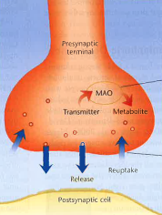
Mood Disorders
Antidepressant Drugs
MOAIs block enzyme MOA preventing it from breaking down neurotransmitters
Tricyclic drugs and SSRIs block reuptake.

Slide 21
Mood Disorders
Antidepressant Drugs
Four types:
4. Atypical Antidepressants
Dopamine and Norepinephrine Reuptake Inhibitors (e.g. Wellbutrin) sometimes used.
St Johns Wort – non-prescription drug has been argued to have similar effect to antidepressant prescription drugs. However it promotes the production of a liver enzyme that breaks down toxins, but also breaks down medication so renders other drugs (including anti-depressant medication!) ineffective.

Slide 22
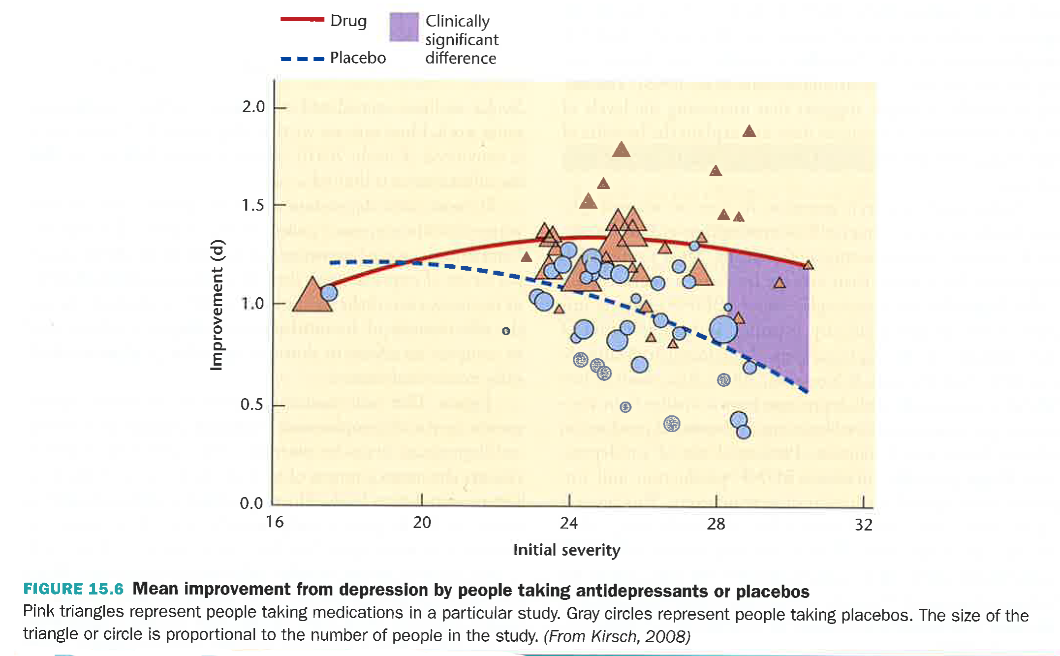
Mood Disorders
Effectiveness of Antidepressant Drugs
No difference between drug and placebo
Significant drug effect here
Notes:
For mild to moderate depression the placebo has a similar effect to the drug

Slide 23
Mood Disorders
Electroconvulsive Therapy (ECT)
Electrically induced seizures. Originally developed as a treatment for schizophrenia.
When it proved unsuccessful in treating schizophrenia it was tried on other mental health conditions and did prove successful in treating depression.
It was misused in the 1950s and patients were given the treatment without their consent. Then drug treatments were developed so it went out of fashion.
Now used in cases of severe depression where drug treatments have failed.
Side effects are memory loss.
Notes:
As schizophrenic symptoms increase seizures decreased so seizure seemed to offer a method to reduce schizophrenia.

Slide 24
Mood Disorders
Electroconvulsive Therapy (ECT)
Not clear exactly how it works to relieve depression, but it does seem to alter the expression of genes in the hippocampus and frontal lobes (Altar et al., 2004).
Similar treatment of transcranial magnetic stimulation often used now. TMS stimulates axons near the surface of the brain, but not clear how exactly this relieves depression.
ECT Video
TMS Video
Notes:
As schizophrenic symptoms increase seizures decreased so seizure seemed to offer a method to reduce schizophrenia.

Slide 25
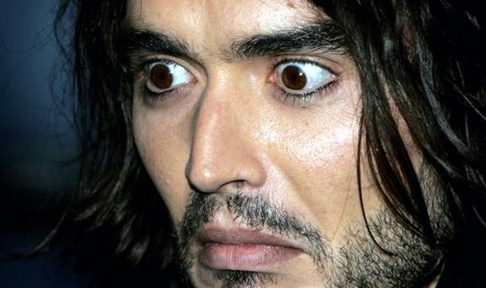
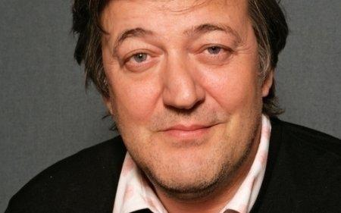
Mood Disorders
Bipolar Disorder
Depression can be unipolar (between normality and one pole or bipolar (varying between two poles – mania and depression). Bipolar disorder previously known as manic depression.
Mania: periods of restless activity, excitement, laughter, self-confidence and loss of inhibition. People with mania become a danger to themselves.
Notes:
As schizophrenic symptoms increase seizures decreased so seizure seemed to offer a method to reduce schizophrenia.

Slide 26
Mood Disorders
Bipolar Disorder
Bipolar I Disorder: People with full blown episodes of mania
Bipolar II Dosorder: People with milder episodes of mania (hypomania)
In addition to mood changes people with bipolar disorder have:
Attention problems
Poor self-control
Problems with verbal memory
Diagnosis of bipolar disorder has increased since the 1990s, especially in teenagers.
1% of people will have bipolar I disorder at some point in their lives.
1% will have bipolar II disorder
2%-3% will have subthreshold bipolar disorder.
Notes:
As schizophrenic symptoms increase seizures decreased so seizure seemed to offer a method to reduce schizophrenia.

Slide 27
Mood Disorders
Bipolar Disorder
Genetic Basis
Genetic predisposition supported by twin studies and adoption studies.
Two genes identified that appear to increase the probability of bipolar II (Nwulia et al., 2007).
Genetic link between major depression and bipolar disorder (Lui et al., 2011). But no strong relationship.
Notes:
As schizophrenic symptoms increase seizures decreased so seizure seemed to offer a method to reduce schizophrenia.

Slide 28
Mood Disorders
Bipolar Disorder - Drug Treatments
Lithium Salts: Stabilize mood preventing a relapse into mania or severe depression. Toxic in high doses and ineffective in low doses.
Valproate & Carbamazepine also prescribed. Sometimes supplemented with antidepressants or antipsychotic drugs (normally prescribed for schizophrenia).
These three medications appear to reduce the number of AMPA type glutamate receptors in the hippocampus – linked with mania.
They also block the synthesis of arachidonic acid that is produced when the brain is inflamed. Bipolar patients show increased gene expression associated with inflammation. Arachidonic acid also countered by omega-3 fatty acids found in seafood. Eating a pound of seafood per week decreases the risk of bipolar disorder (Noaghiul & Hibbeln, 2003)
Notes:
As schizophrenic symptoms increase seizures decreased so seizure seemed to offer a method to reduce schizophrenia.

Slide 29
Mood Disorders
Bipolar Disorder - Other Treatments
Circadian rhythm affected in the depressed phase – spend long periods in bed.
In the manic cycle they get very little sleep.
The intensity of mood swings can be reduced by encouraging a healthy sleep cycle in a quiet, dark room.
Notes:
As schizophrenic symptoms increase seizures decreased so seizure seemed to offer a method to reduce schizophrenia.

Slide 30

Mood Disorders
Seasonal Affective Disorder (SAD)
Form of depression most prevalent in polar regions of the world where the winter nights are longest (Haggarty et al., 2002).
Seldom as severe as major depression.
Treated with a bright light. Often treatment is successful within one week (Kripke, 1998).
Possible link with Vitamin D deficiency.

Slide 31
Mood Disorders
Summary
No strong genetic link. Can be related to viral or hormonal changes.
Associated with decreased activity in left hemisphere.
Antidepressants can be effective for severe cases, but for mild cases placebo effects are as large.
Can also be treated with ECT, TMS or light therapy in SAD or increased vitamin D.
In bipolar disorder a regular sleep pattern is also helpful.
Notes:
As schizophrenic symptoms increase seizures decreased so seizure seemed to offer a method to reduce schizophrenia.

Slide 32
Video
Schizophrenia
Term means split-mind. Bleuler (1911) was referring to the split between emotional and intellectual aspects of experience. A patient would cry for no apparent reason or show no response to bad news.
Diagnosis (DSM IV)
Deterioration in everyday functioning (work, relationships, personal care) for at least 6 months and must exhibit 2 of the following positive and negative symptoms not attributable to other disorders:
Delusions (e.g., being controlled by aliens)
Hallucinations (e.g., hearing voices)
Disorganized Speech (rambling or incoherent)
Grossly Disorganized Behaviour
Weak or Absent Signs of Emotion, Speech and Socialization.
Notes:
As schizophrenic symptoms increase seizures decreased so seizure seemed to offer a method to reduce schizophrenia.

Slide 33
Schizophrenia
Positive Symptoms (Behaviours that are present but should be absent).
Negative Symptoms (Behaviours that are absent but should be present). These are usually stable across time but are difficult to treat.
Cognitive Symptoms
Not part of the diagnostic criteria, but Schizophrenics tends to have lower IQ (Woodberry et al., 2008), and deficits in attention and working memory (Hanlon et al., 2005). Also have problems with abstract concepts.
Memory impairment could be the root of the disordered thoughts that characterize schizophrenia (Andreasen, 1999).
Notes:
As schizophrenic symptoms increase seizures decreased so seizure seemed to offer a method to reduce schizophrenia.

Slide 34
Schizophrenia
Prevalence in the Population
Worldwide 1% of people suffer with schizophrenia at some point in their lives.
Significantly more common in cities than in rural communities.
10 to 100 times more common in the US and Europe than in Third World Countries. Diet?
Diets high in sugar and saturated fat common in prosperous countries aggravates schizophrenia whereas diets rich in omega-3 fatty acid from fish and seafood alleviate it (Peet, 2004).
Male: Female ratio of 7:5. More severe in men and earlier onset.
Schizophrenics have problems keeping eyes on a moving target.
Notes:
As schizophrenic symptoms increase seizures decreased so seizure seemed to offer a method to reduce schizophrenia.

Slide 35
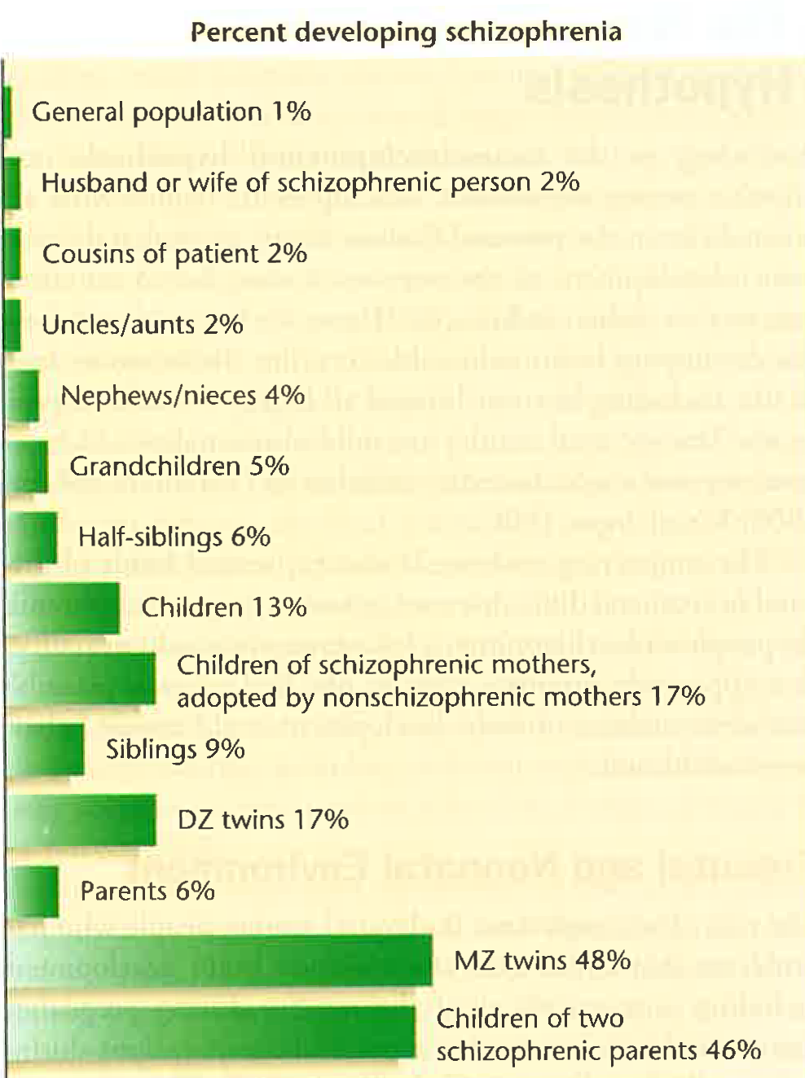
Schizophrenia
Genetics
As the genetic link increases so does the probability of developing schizophrenia. Suggests a genetic link.
But:
MZ twins have 50% concordance. Could be linked to a gene active in one and not the other, or to environmental factors.
DZ twins have same genetic resemblance as siblings but higher probability. But both share the same environment?
Notes:
As schizophrenic symptoms increase seizures decreased so seizure seemed to offer a method to reduce schizophrenia.

Slide 36
Schizophrenia
Genetics
Schizophrenia it is more common in their biological family than their adopted one for adopted schizophrenic children (Kety et al., 1994).
Suggestion of a genetic basis, but may also be accounted for by prenatal environmental influences.
Schizophrenic mothers:
Drink, smoke, take drugs and eat a poor diet during pregnancy.
Have a disproportionate risk of complications during pregnancy.
Higher incidence of schizophrenia in adopted children with biological parents with schizophrenia AND disordered adoptive family
Suggests environmental factors contribute as well.
Notes:
As schizophrenic symptoms increase seizures decreased so seizure seemed to offer a method to reduce schizophrenia.

Slide 37
Schizophrenia
Prenatal and Neonatal Environment
Risk of Schizophrenia elevated by:
Poor nutritional intake of mother during pregnancy
Premature birth
Low birth weight
Complications during pregnancy
Exposure of mother to extreme stress
Head injuries in early childhood
Mother of Rh-negative and has a Rh-positive baby, the baby’s blood factor may trigger an immunological rejection by the mother. This rejection response is weak in first births but exacerbated in later births leading to hearing defects, mental retardation and twice the probability of schizophrenia.
Season of birth: 5%-8% more likely to develop schizophrenia if born in winter – nutrition, viral infection.
Notes:
Viral infections common in autumn and thus affect winter births.

Slide 38
Schizophrenia
Prenatal and Neonatal Environment
Season of birth: 5%-8% more likely to develop schizophrenia if born in winter – nutrition, viral infection.
Records of tens of thousands of English, Scottish and Danish people examined and schizophrenia rates increased 2-3 months after major influenza epidemics (Adams et al., 1993).
Also, increased incidence of influenza virus in mothers who’s children eventually developed schizophrenia
Schizophrenia rates also higher in mothers who had German measles, herpes and other infections during pregnancy.
Notes:
Viral infections common in autumn and thus affect winter births.

Slide 39
Schizophrenia
Postnatal Environment
Toxoplasma Gondii (remember lecture 10 on emotion).
Infected infants have impaired brain development. Impairs memory, leads to hallucinations and delusions.
Adults with a diagnosis of schizophrenia are more likely to have had a pet cat in childhood.
Blood tests also show higher concentration of toxoplasma antibodies in schizophrenics than in the general population.
86% Mexican Schizophrenics, 50% of European Schizophrenics had the antibodies compared with <40% of non-schizophrenic patients.
Also link to bipolar disorder and Toxoplasma Gondii.

Slide 40
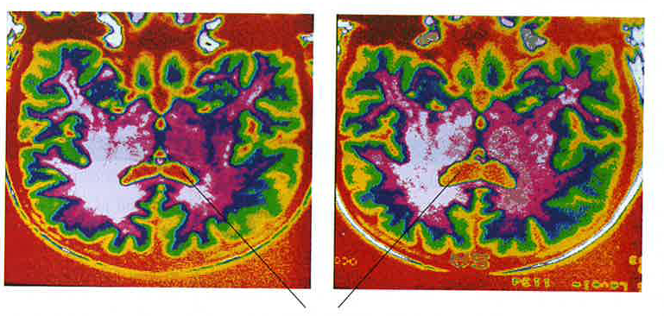
Schizophrenia
Brain Abnormalities
Associated with larger than average brain ventricles.
Ventricles
Twin on the left has schizophrenia and the one on the right does not.

Slide 41
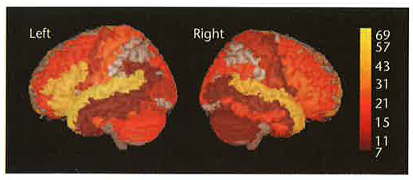
Schizophrenia
Brain Abnormalities
Less than average gray matter and white matter in the brain.
Largest difference in temporal (including the hippocampus) and prefrontal areas of the brain (yellow). In particular weaker connections between PFC and other brain areas. Thalamus also smaller.
Schizophrenics show deficits in PFC functions (attention & memory.
Notes:
PFc mature slowly. So not clear in schizophrenia develops over time. Some disagreement in the literature on this. May be the reason that most diagnoses occur around the age of 20 when this area is mature and the extent of the deficit is apparent.

Slide 42
Schizophrenia
Antipsychotic and neuroleptic drugs such as Clopromazine (Thorazine) and Haloperidol are used to treat schizophrenia.
Each of the drugs block dopamine synapses.
Suggestion that neurons synthesize and release dopamine faster and synthesize higher concentrations in specific areas (e.g., basal ganglia).
Elevated dopamine is also a key symptom in first episodes.
But lower than normal release of glutamate and fewer than normal number of receptors in PFC and hippocampus.
Narcotics such as PCP inhibits glutamate receptors and in high doses mirror schizophrenic symptoms.

Slide 43
Schizophrenia
Summary
Some indication of genetic predisposition but only 50% correspondence in MZ twins.
Also evidence for environmental factors (viral infection, diet, drug use, stress).
Brain abnormalities in temporal lobe (including the hippocampus), PFC and ventricles. Associated attention and memory impairment also.
Drugs that block dopamine help to reduce the positive symptoms.
Suggestion that low glutamate also related to schizophrenia.
Notes:
PCP: Phencyclidine (Angel Dust). Has largest effect when administered to adults

Slide 44
Lecture 12: Abnormal Psychology
Reading: Kalat, Chapter 15

